Slide 1
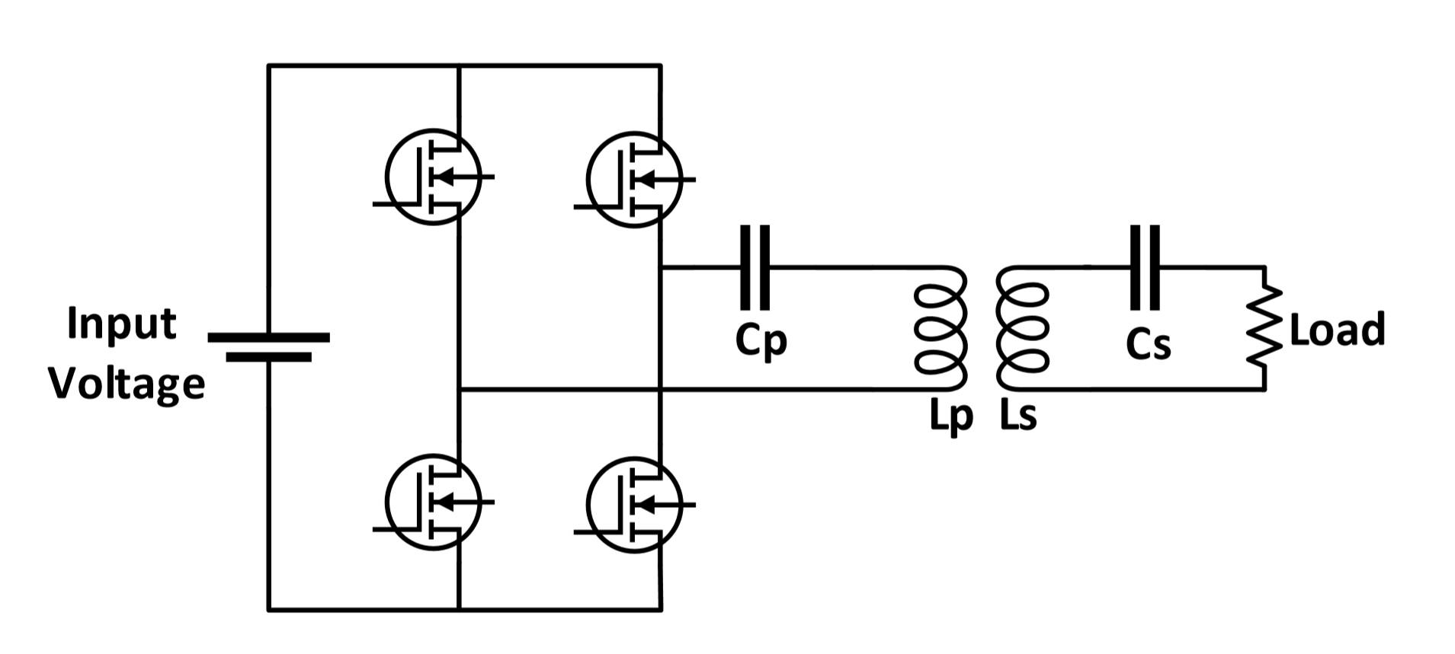
Series-Series Compensated Resonance Converter
Series-Series Compensated System :
Resonance Frequency is independent from load
Resonance Frequency is independent of coupling coefficient
However, no-load condition or very low mutual condition is a issue

Slide 2
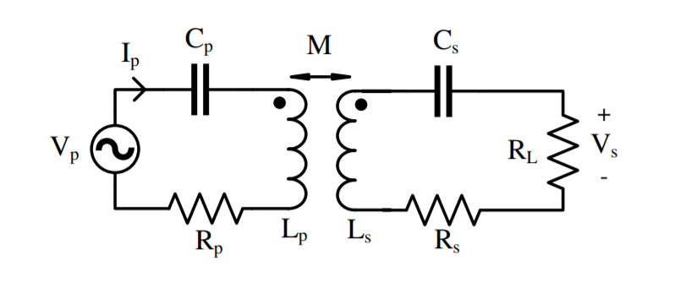
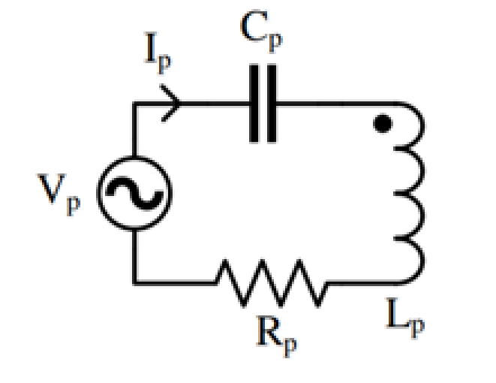
No load Condition
Short-circuited primary.
Actually, primary is not coupled with any load. Thus, the primer current at resonance frequency is restricted with only parasitic resistance and inductor resistance.

Slide 3
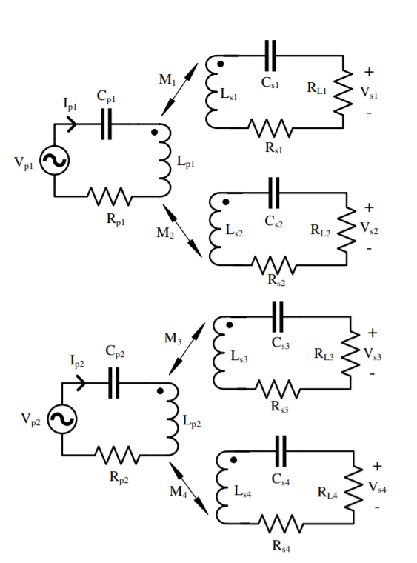
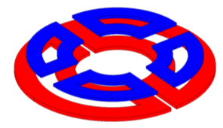
Solution for no-load condition
Modular Design :
2 Primary and 4 Secondary
A primary is coupled with at least two secondary.

Slide 4
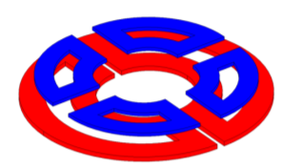
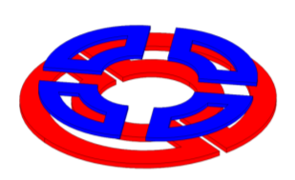
Rotational Misalignment
In our sytem, secondary side windings are rotated.
45°
Fully aligned secondaries with primaries. (0° )
Misaligned secondaries with primaries. (45°)
Thus, rotation does not cause a no-load condition for primary side.

Slide 5
Primary Winding
2 half circle with a hole for motor shaft
Why does not it have a circular shape ? Beacuse is it required to mount motor without any mechanical decomposition

Slide 6
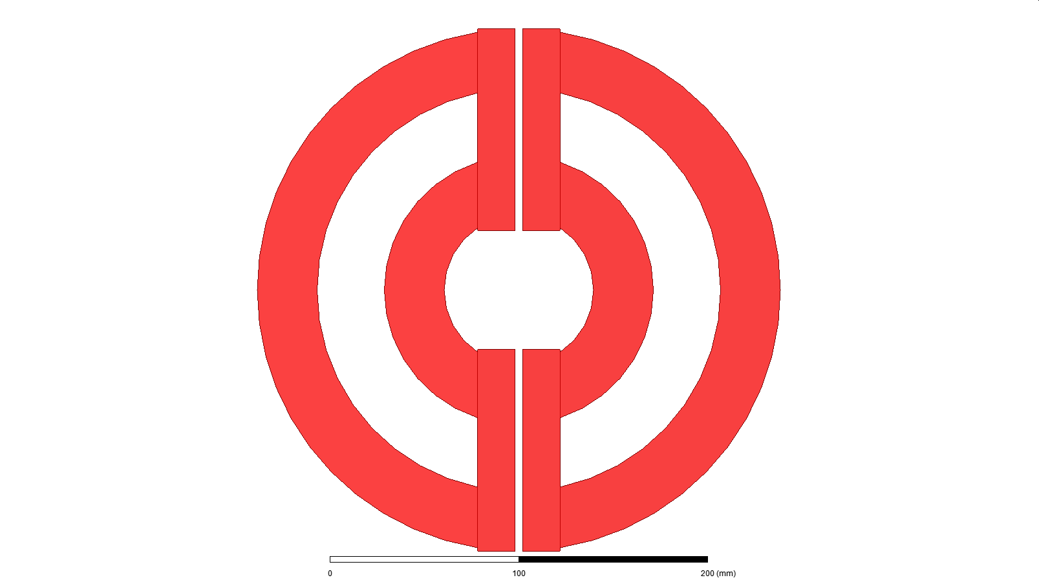
Formerly Proposed Design
Top view
(only windings)
Modular design
Primary windings can be thought as decoupled (0.05 coupling coefficient)
Not giving a constant flux
Flux is destroyed at transition between two primaries
Constant flux regions
Flux distortion region

Slide 7
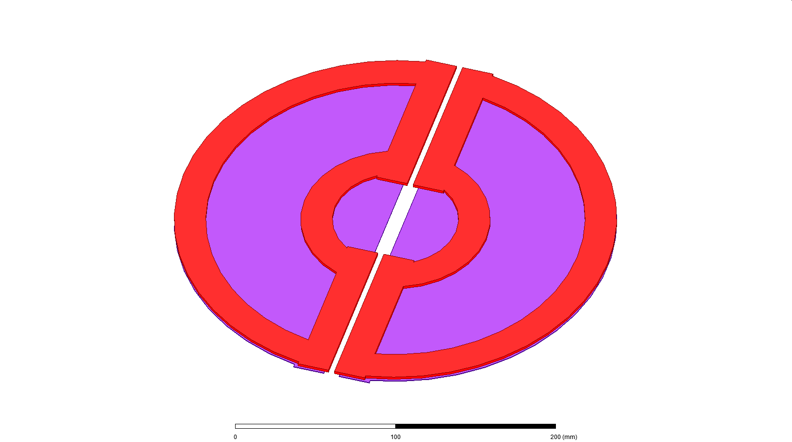
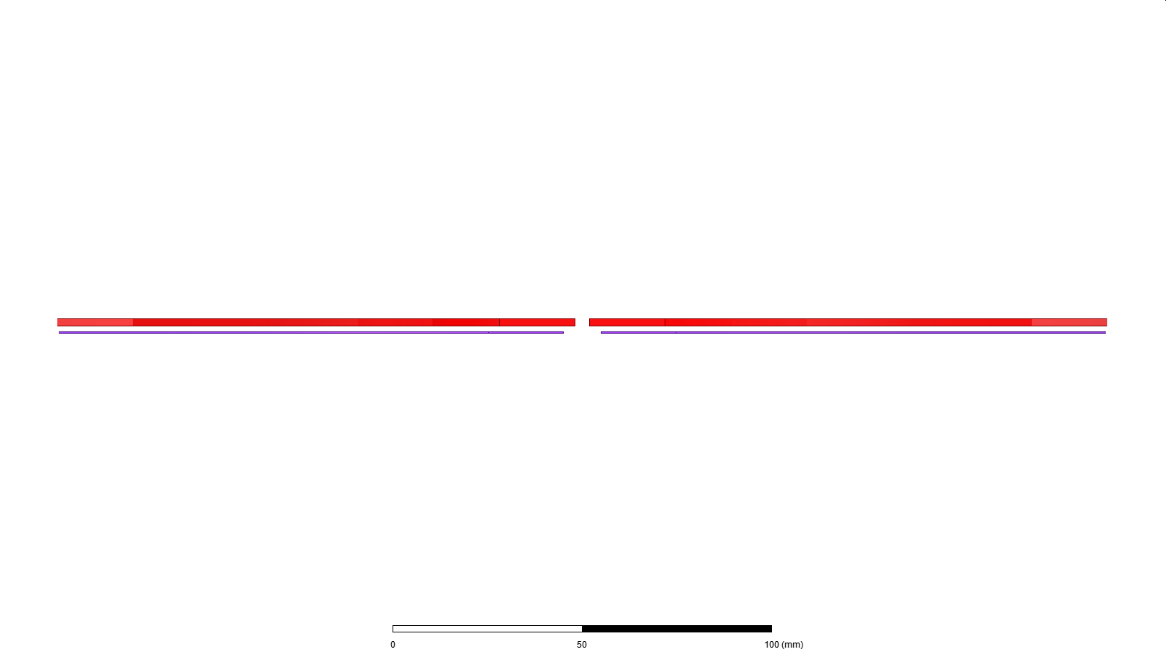
Winding(Red)
Ferrite(Purple)
Sideview

Slide 8
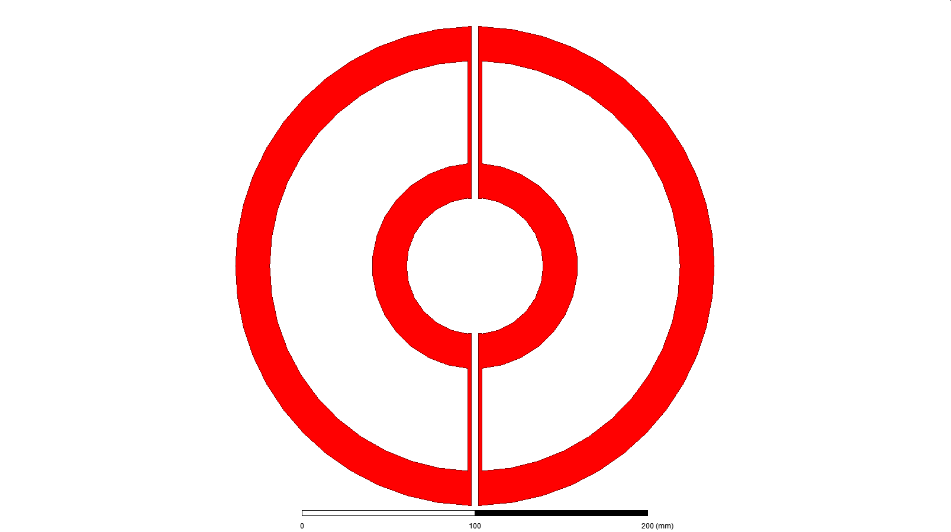
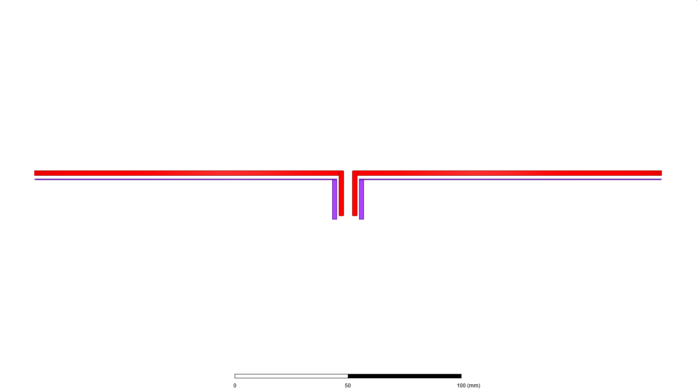
Proposed Design
Problem: Flux distribution is not constant
Solution : Bended endwindings of primary winding

Slide 9
Pros and Cons
Primary to primary flux is bigger than expectation .
Flux change is 10 percent between fully aligned and transition between two primaries.
Primary to primary flux
Change on flux is 10 percent
Primary to primary flux
Constant Flux

Slide 10
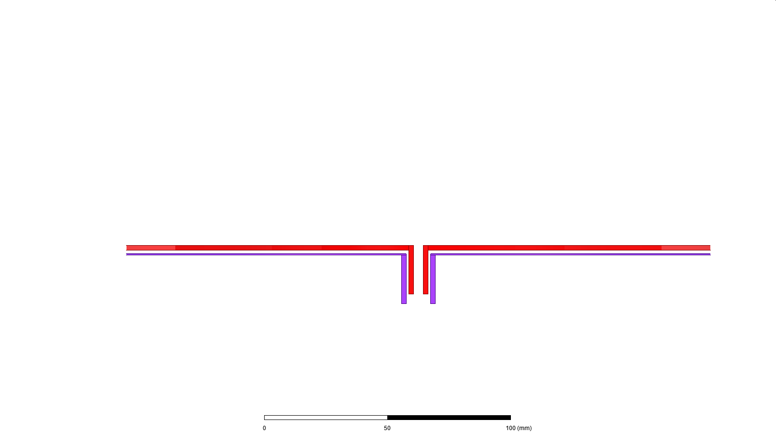

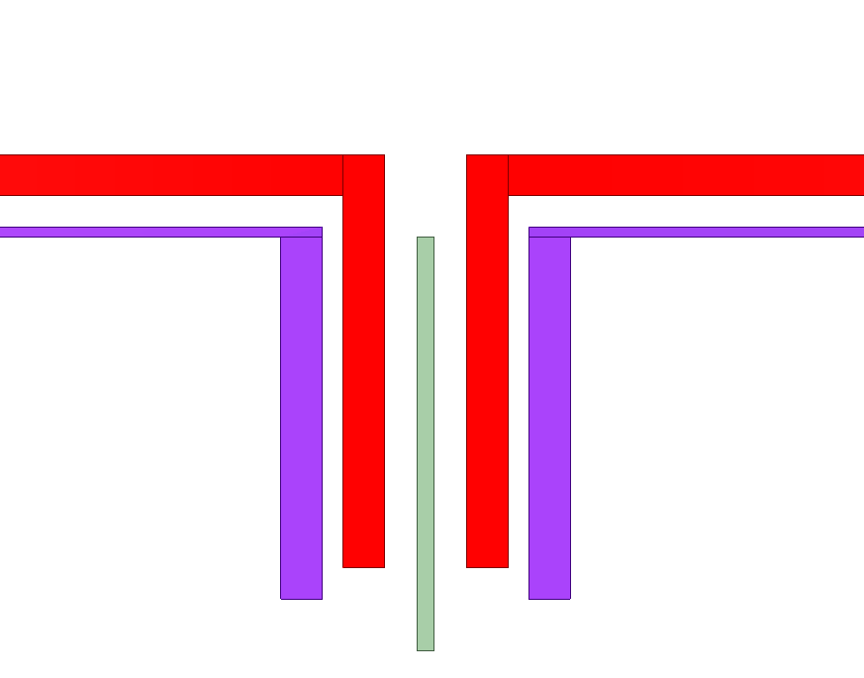
How can we decrease mutual indcutance between two primary windings?
Solution: Middle Ferrite core to decouple two primary windings
Middle core ferrite
(Decoupled
primary windings)

Slide 11
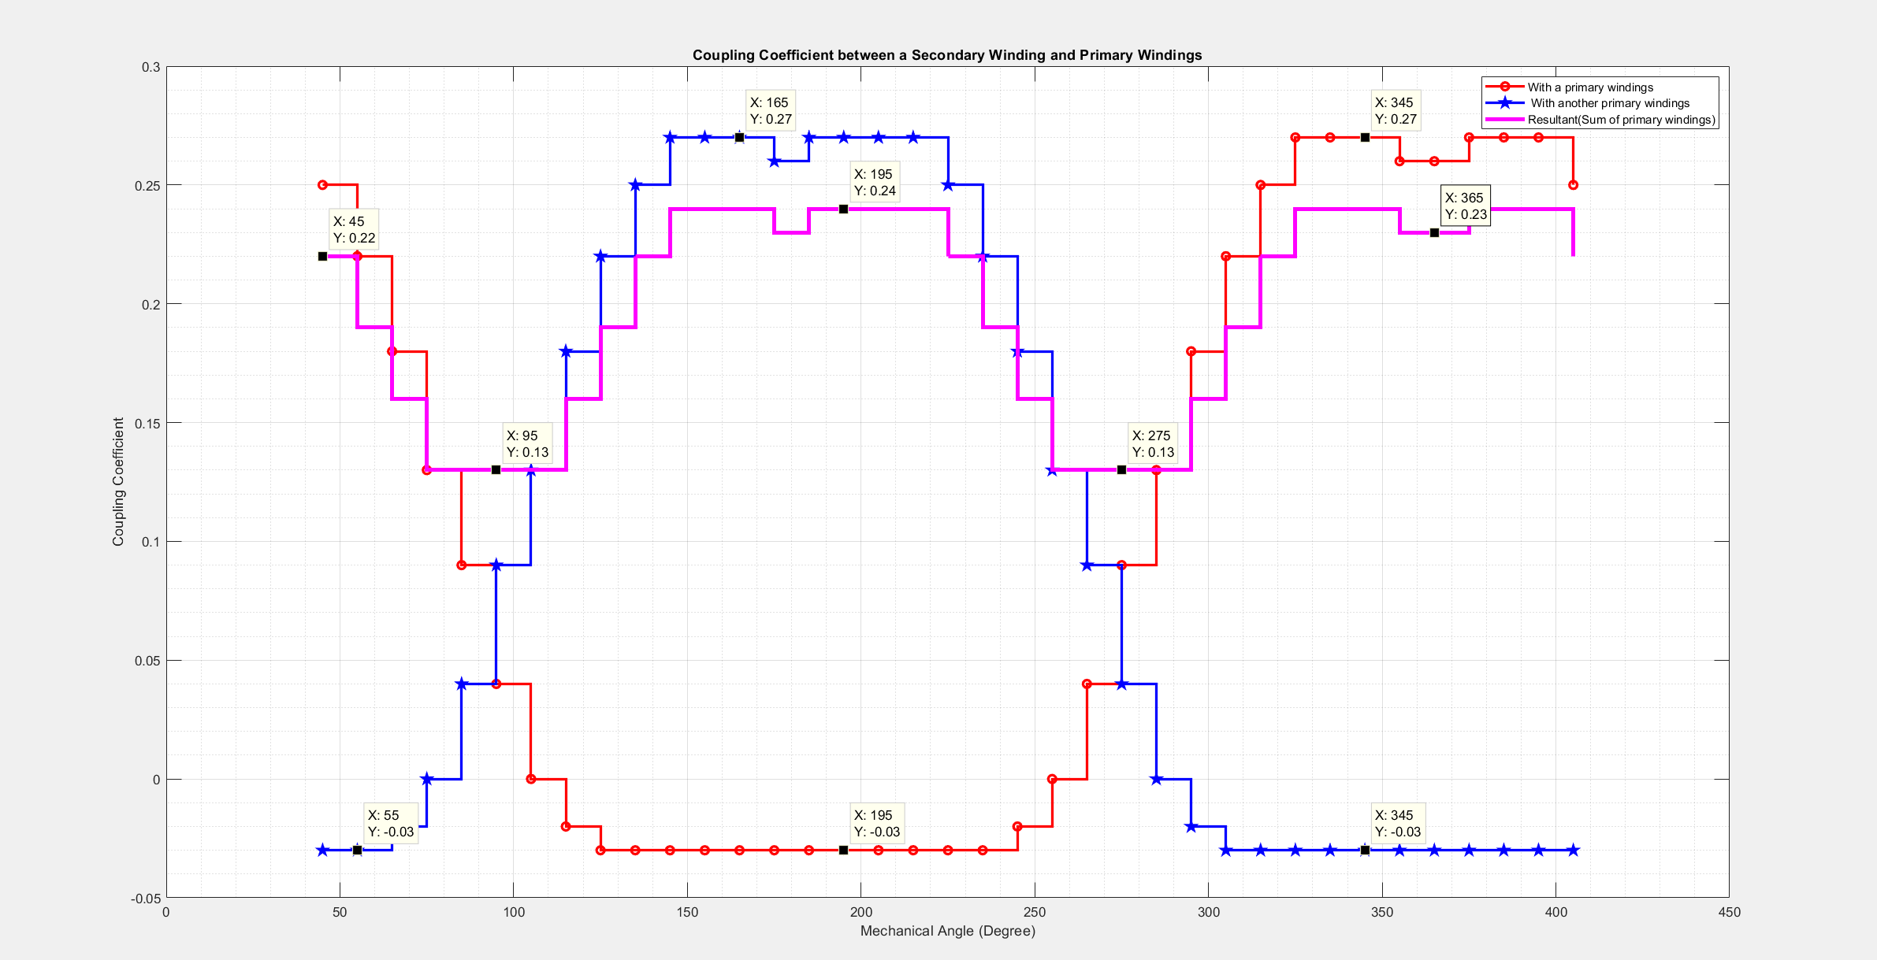
Results for Previous

Slide 12
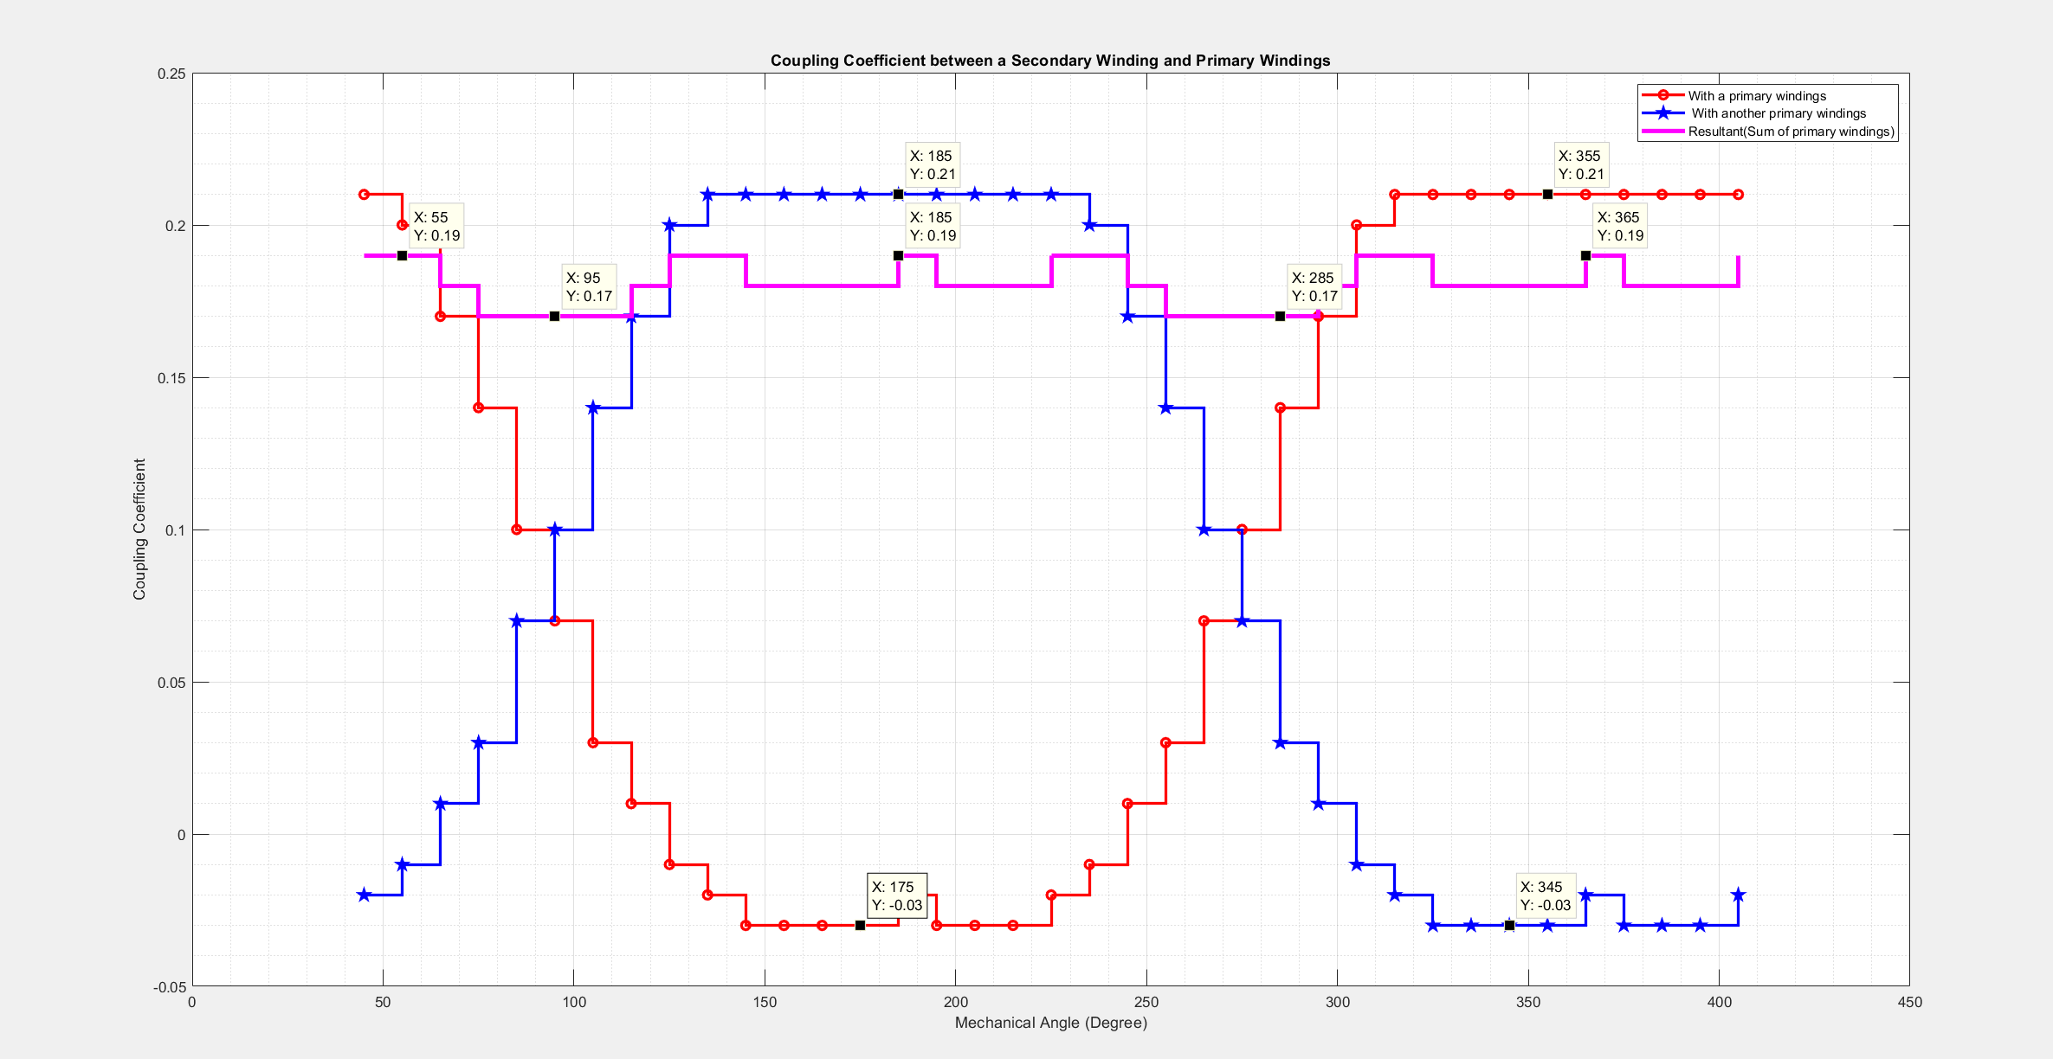
Results for Proposed

Slide 13
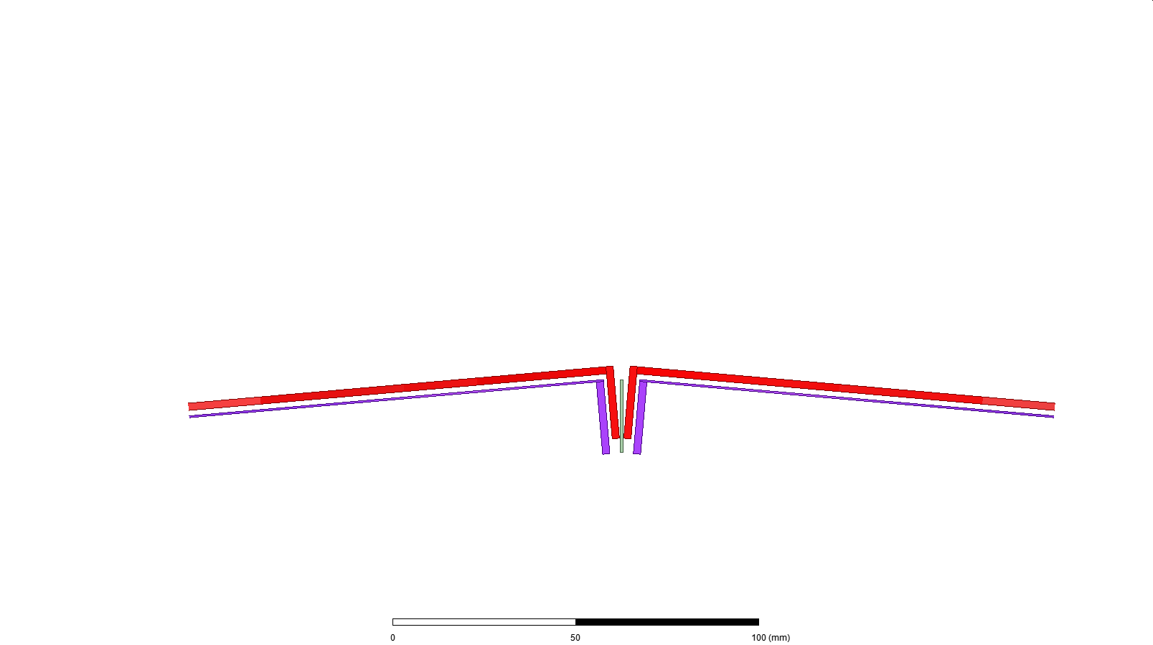
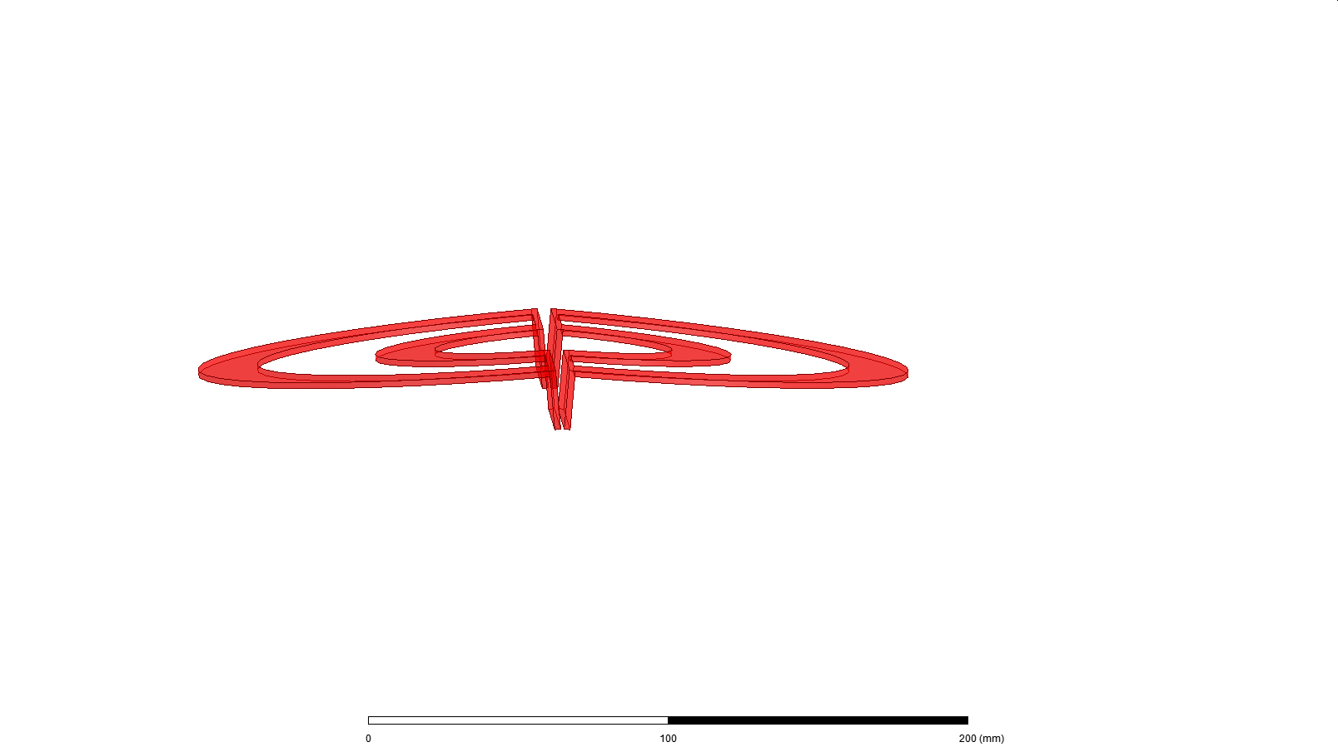
Bonus Solution:
Solution: Changing Air gap.
Airgap is adjusted to make linked flux distribution constant. Thus, bended with a determined slope.

